Slide 1

사물인터넷개론
202135599 황성민
202035398 한규상
202035515 김태규
202334274 김용진
Term project Team E
Project Overview

Slide 2
Contents
01. PROJECT OVERVIEW
03. SENSOR AND HARDWARE COMPONENTS
02. TECHNICAL DESIGN IMPLEMENTATION
04. TEAM CONTRIBUTIONS

Slide 3
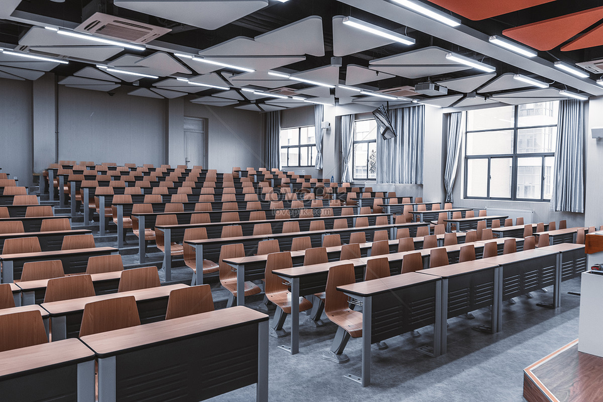
01. Project Overview
Proposal Background
"We present ClassGuardian, an ESP32-based smart system that ensures classroom safety and environmental comfort. It integrates intrusion detection, fire alerts, and air conditioning control into a single, reliable IoT solution."
Problem Statement: Classroom safety and environment management are often neglected after hours.
Objective: Real-time detection and smart response using low-cost IoT components.
➤ Need to prepare for threats

Slide 4
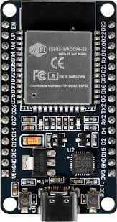
02. Technical design implementation
Project Architecture
"Our system consists of multiple sensor modules connected to ESP32 boards, divided into sensor nodes, a bridge node, and a server node."
Divided into 4 main boards: Sensor Boards (2), Bridge, Server
Modular and scalable design
Wired Serial communication ensures stable data transfer

Slide 5
03. Sensor and Hardware Components
Key Features
"Our system performs three main functions that work in parallel and communicate with each other."
Intrusion Detection
PIR motion sensor triggers image capture
Camera captures evidence → sent to server

Slide 6

03. Sensor and Hardware Components
Key Features
Fire Detection
Smoke or flame detection activates alarm
Sends warning signal to server

Slide 7
03. Sensor and Hardware Components
Key Features
Environment Control
Temp/Humidity thresholds adjust cooling system
Remote override using IR controller

Slide 8
03. Sensor and Hardware Components
Data Flow and Communication
"For reliable and fast data transmission, we use BLE communication between Sensor board and Bridge board"
SENSOR
Sensor Boards collect data
BLE
BRIDGE BOARD
SERVER BOARD
send to Bridge →
computes data → forwarded to Server
Server handles integration, alerts, and data storage/logging
SENSOR
BLE
Sensor Boards collect data

Slide 9



03. Sensor and Hardware Components
Data Flow and Communication
Firebase enables real-time remote access and control from any location via the cloud.
We use wired serial connections between Bridge and Server boards to reduce resource overhead.
BRIDGE BOARD
SERVER BOARD
send to Bridge →
computes data →
forwarded to Server
Wired Serial Connection
Server handles integration, alerts, and data storage/logging

Slide 10
04. Team Contributions
"Each team member is responsible for a key part of the system, ensuring parallel development and smooth integration."
Taegyu Kim: Motion sensor + Camera module implementation
Yongjin Kim: Fire + Temperature/Humidity sensor setup
Kyusang Han & Sungmin Hwang: Bridge & Server communication design / Firebase cloud connection
Collaboration via GitHub, hardware testing in shared workspace

Slide 11
THANK YOU
감사합니다

